Slide 1
NUTRITION AGENT
CAPSTONE PROJECT
Presented By:
Anuj Jugran – Graphic Era Hill University - CSE

Slide 2
OUTLINE
Problem Statement (Should not include solution)
Proposed System/Solution
System Development Approach (Technology Used)
Algorithm & Deployment
Result (Output Image)
Conclusion
Future Scope
References

Slide 3
Problem Statement
Problem Statement No.8- Nutrition Agent
Maintaining a balanced diet is essential for health, but individuals often lack access to personalized, real-time nutritional guidance tailored to their preferences, dietary restrictions, and health goals. The challenge is to develop a system that delivers accurate, context-aware, and multilingual dietary recommendations in dynamic scenarios like meal planning or grocery shopping, without relying on a specific dataset.

Slide 4
Proposed Solution
The Agentic AI Nutrition Agent utilizes the Llama 3.3 70B Instruct model, hosted on IBM Cloud’s Watsonx.ai platform, to provide personalized, multilingual dietary recommendations based on user queries.
Input Handling • Accept user inputs (e.g., dietary preferences, allergies, health goals, and contextual details like meal timing or location) via natural language queries in supported languages (English, German, French, Italian, Portuguese). • Leverage real-time inputs from user interactions or integrated devices (e.g., fitness trackers, smart kitchen appliances) without requiring a pre-collected dataset.
Machine Learning Algorithm • Use the Llama 3.3 70B Instruct model for natural language understanding and generation to interpret queries and generate tailored recommendations. • Employ the model’s pre-trained knowledge and reinforcement learning with human feedback (RLHF) to align responses with user preferences and nutritional guidelines. • Incorporate contextual analysis to provide time- and location-aware suggestions (e.g., breakfast options based on morning queries).
Deployment • Deploy the Nutrition Agent on IBM Cloud using Watsonx.ai Runtime service, leveraging Llama 3.3’s FP8 quantized weights for efficient inference. • Develop a multilingual user interface (web/mobile app) supporting English, German, French, Italian, and Portuguese. • Enable API integration for third-party applications (e.g., fitness apps, smart kitchen devices).
Evaluation • Evaluate performance using metrics like recommendation relevance, user satisfaction (via feedback), and adherence to nutritional guidelines. • Monitor response quality in real-world scenarios, refining prompts or model interactions based on user feedback.

Slide 5
System Approach
The system is built on IBM Cloud, utilizing Watsonx.ai to host the Llama 3.3 70B Instruct model for scalable, multilingual AI capabilities.
System Requirements
Hardware: IBM Cloud infrastructure with GPU support for Llama 3.3 inference.
Software: Watsonx.ai Runtime, Python for scripting, and REST APIs for integration.
Input Sources: Real-time user queries and device inputs (no pre-collected dataset).
Libraries Required
Python Libraries: requests (for API calls), Flask/Django (for web interface).
Watsonx.ai SDK: For model interaction and deployment.
Visualization Tools: Matplotlib/Seaborn for result analysis (if needed).

Slide 6
Algorithm & Deployment
Model: Llama 3.3 70B Instruct (FP8 quantized), optimized for multilingual dialogue.
Justification: 128k context length, pre-trained knowledge, and RLHF tuning enable complex, context-aware nutritional queries without extra training data.
Input Handling
Inputs: User queries (e.g., “low-carb dinner”), preferences (e.g., vegan), and context (time, location).
Multilingual: Supports English, German, French, Italian, Portuguese.
Real-Time Data: Integrates with APIs (e.g., wearables for calorie burn).
Processing
Uses pre-trained knowledge to generate recommendations without custom datasets.
RLHF aligns responses with nutritional best practices.
Contextual analysis tailors suggestions (e.g., lighter meals at night).
Deployment
Log in to IBM Cloud (cloud.ibm.com) → Watsonx.ai.
Create sandbox project, link Watsonx.ai Runtime.
Select Llama 3.3 70B Instruct from foundation models.
Add API tools (e.g., nutritional guidelines).
Create deployment space, generate API key, deploy agent.
Test queries, monitor deployment, ensure multilingual support and secure API access.

Slide 7
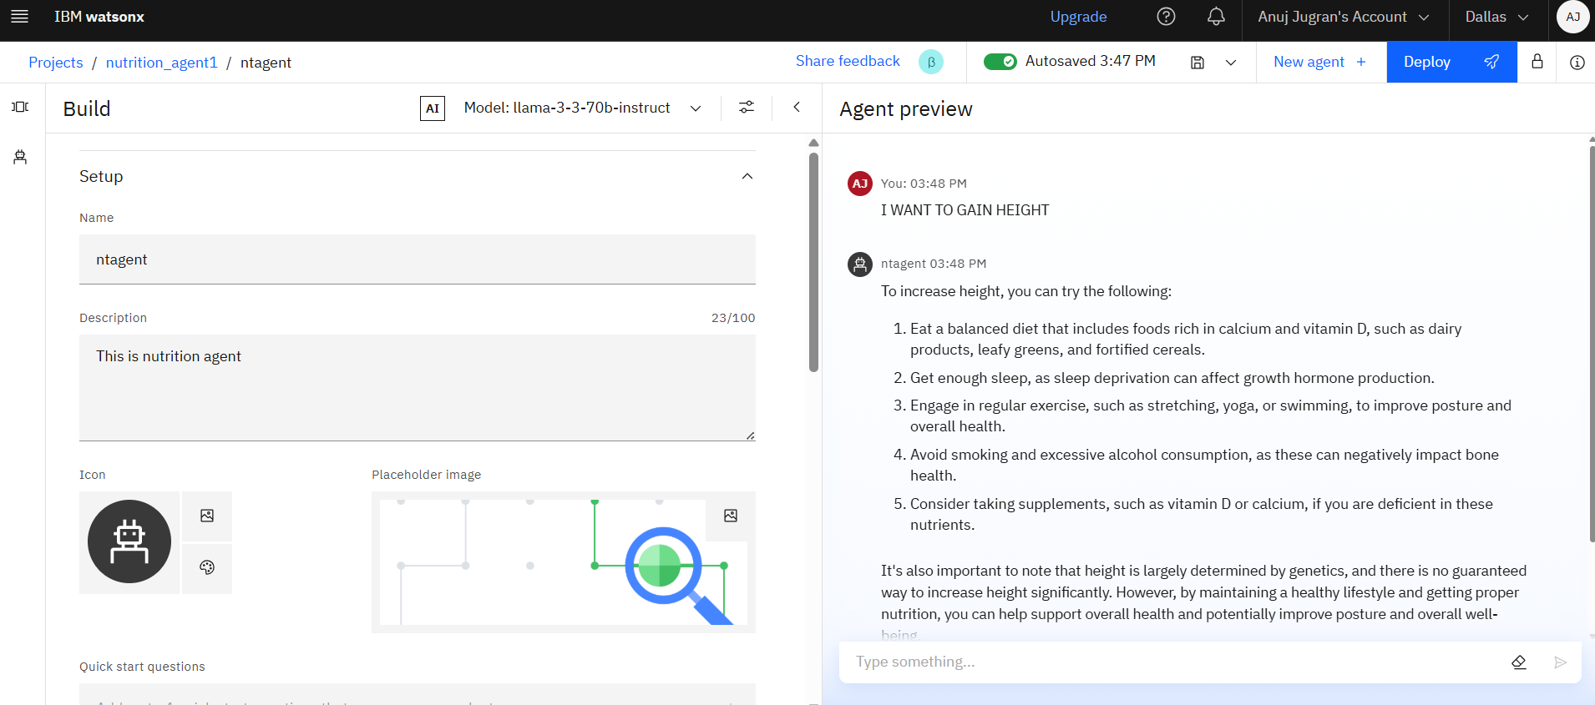
Result

Slide 8
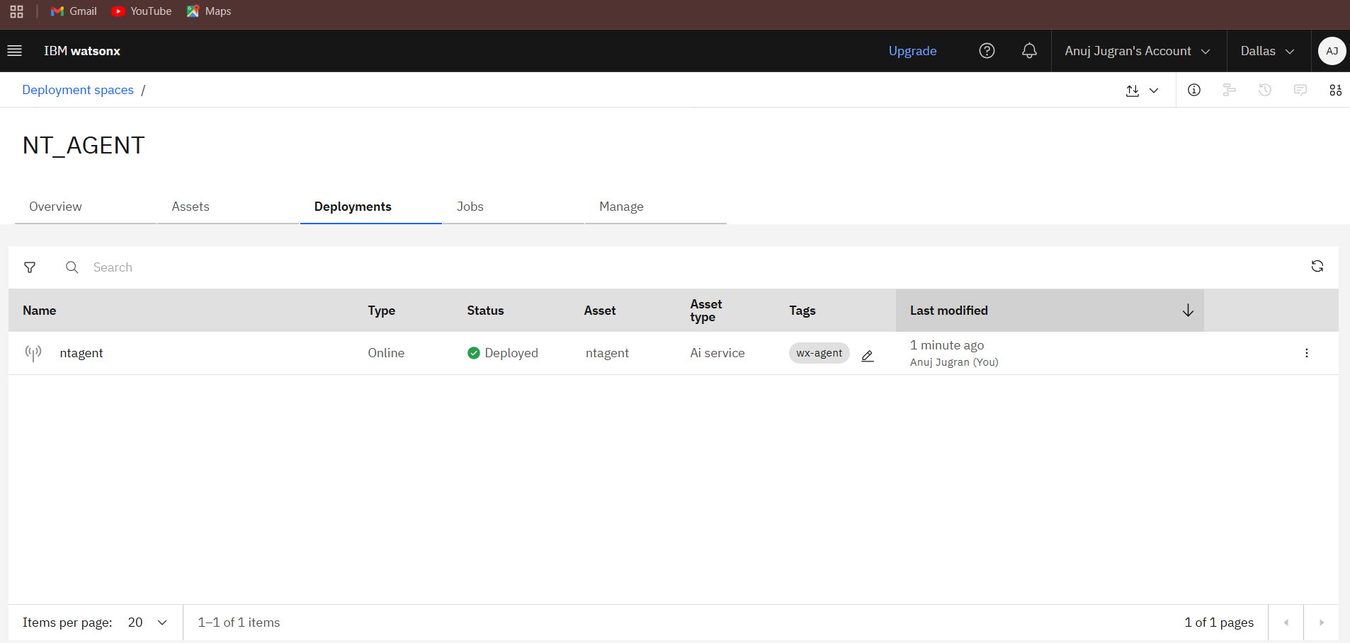

Slide 9
Conclusion
The Agentic AI Nutrition Agent, powered by Llama 3.3 70B Instruct, effectively provides personalized, multilingual dietary recommendations without requiring a dataset. Leveraging IBM Cloud and Watsonx.ai, the system ensures scalability and user-friendly interaction. Challenges include ensuring cultural relevance across languages and maintaining privacy, addressed through secure deployment and RLHF. The solution promotes healthier dietary choices through accessible, real-time guidance.

Slide 10
Future scope
Enhance cultural adaptation for dietary recommendations across diverse regions.
Integrate additional input sources (e.g., IoT devices) for richer context.
Expand language support beyond the current five languages.
Explore edge computing for offline functionality in smart devices.

Slide 11
References
IBM Watsonx.ai Documentation: https://cloud.ibm.com/docs/watsonx
Meta Llama 3.3 Model Card: https://www.llama.com/docs/model-cards-and-prompt-formats/
“AI-Driven Personalized Nutrition,” Journal of AI in Healthcare, 2023 : https://ieeexplore.ieee.org/abstract/document/10842744/
“Multilingual LLMs for Conversational AI,” arXiv, 2023 : https://arxiv.org/html/2411.11072v1
IBM Cloud API Reference: https://cloud.ibm.com/apidocs

Slide 12
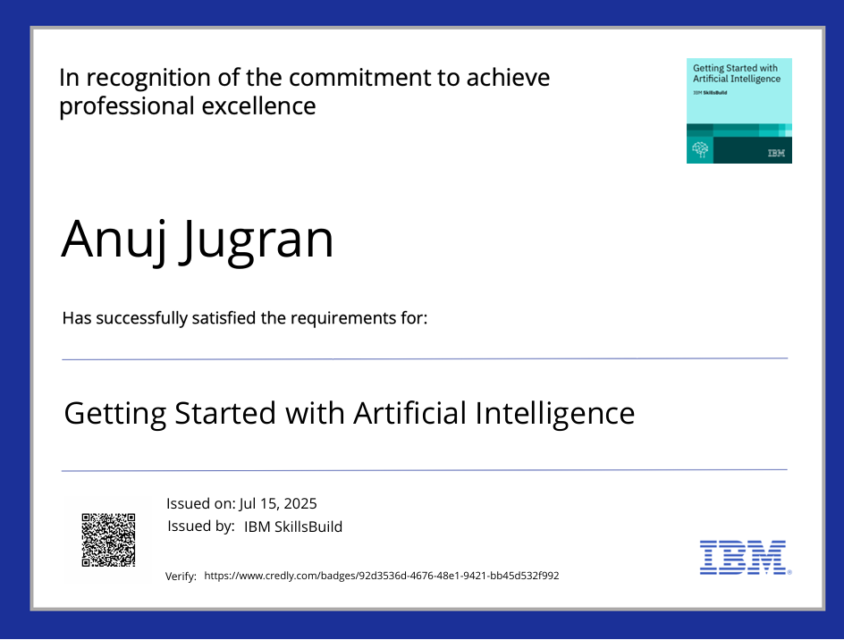
IBM Certifications
Screenshot/ credly certificate( getting started with AI)

Slide 13
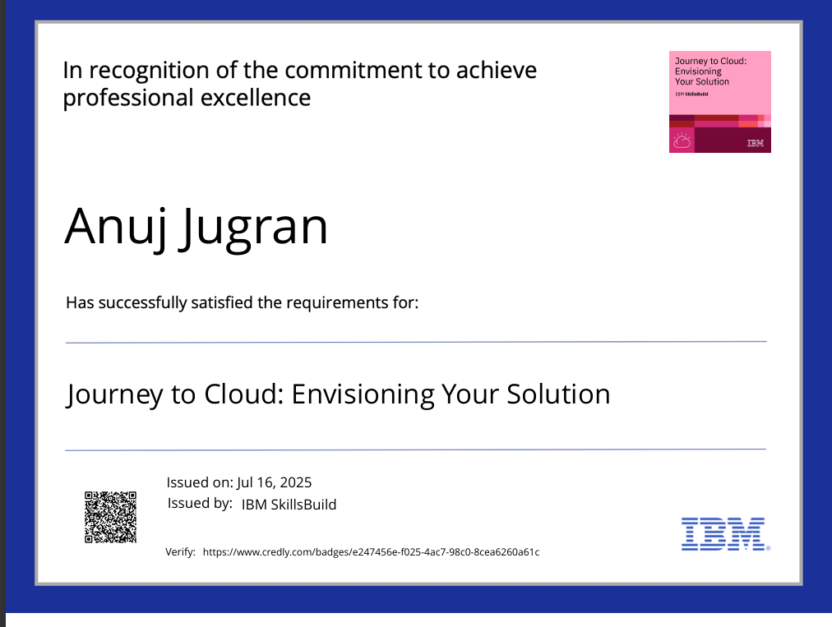
IBM Certifications
Screenshot/ credly certificate( Journey to Cloud)

Slide 14
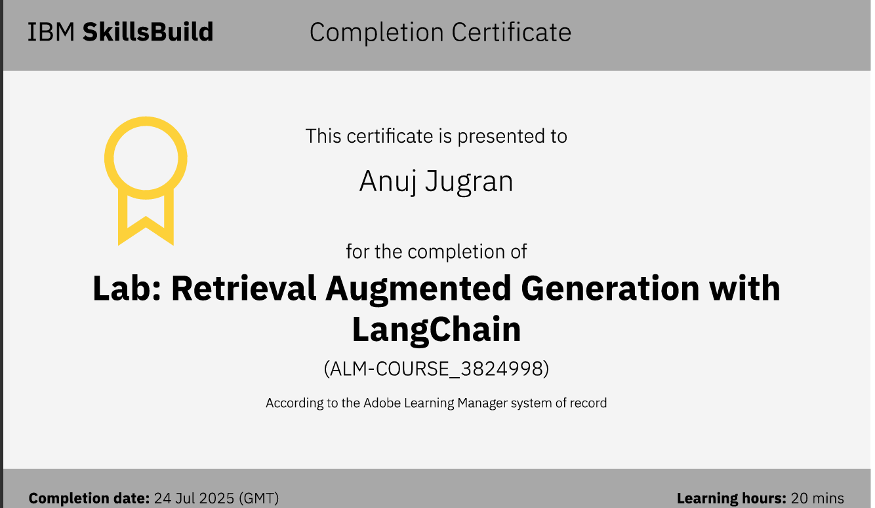
IBM Certifications
Screenshot/ credly certificate( RAG Lab)

Slide 15
THANK YOU

